Slide 1
Anesthetic machine in veterinary medicine
Assistant prof Luay A. Naeem

Slide 2
Anesthetic machine
The most important piece of equipment that the anaesthesiologist uses is the anaesthesia machine.
Safe use of anaesthesia machine depends upon an interaction between the basic design of the machine with its safety features and the knowledge and skills of the anaesthesiologist.
The basic function of an anaesthesia machine is to prepare a gas mixture of precisely known, but variable composition.
The gas mixture can then be delivered to a breathing system.

Slide 3
Anaesthesia machine itself has evolved from a simple pneumatic device to a complex array of mechanical, electrical and computer – controlled components.
Much of the driving force for these changes have been to improve patient safety and user convenience.
Though many modifications have been brought out still the basic design has not much changed. Hence, knowledge of the basic design of the anaesthesia machine is a must for all the practicing anesthesiologists to understand the modern anesthesia workstation.

Slide 4
Aims of the study
study the components and parts of anesthetic machine with knowing the function of each part.
To assessment the use of Anesthetic machines in educational veterinary medicine/ College of Veterinary Medicine/ University of Basrah.

Slide 5
History of anesthetic machine
Invented by the British anesthetist Henry Boyle
Hospital of London
1917

Slide 6
Veterinary anesthesia
Is anesthesia performed on non-human animals by a veterinarian or a Registered Veterinary Technician. Anesthesia is used for a wider range of circumstances in animals than in people, due to animals' inability to cooperate with certain diagnostic or therapeutic procedures. Veterinary anesthesia includes anesthesia of the major species well as all other animals requiring veterinary care such as : dogs, cats, horses, cattle, sheep, goats, and pigs, birds and wildlife animals.

Slide 7
Anesthetic techniques are subdivided in to two main classes: 1- Local anesthesia. 2- Regional anesthesia 2- General anesthesia.

Slide 8
General anesthesia: general anesthesia is the induction of a state of unconsciousness with the absence of pain sensation over the entire body.

Slide 9
General Anesthesia
There are Tow type of general anesthesia that dependent on Mode Of Administration:
1- Injection G.A. 2- Inhalation G.A.
In inhalation type use anesthetic machine

Slide 10
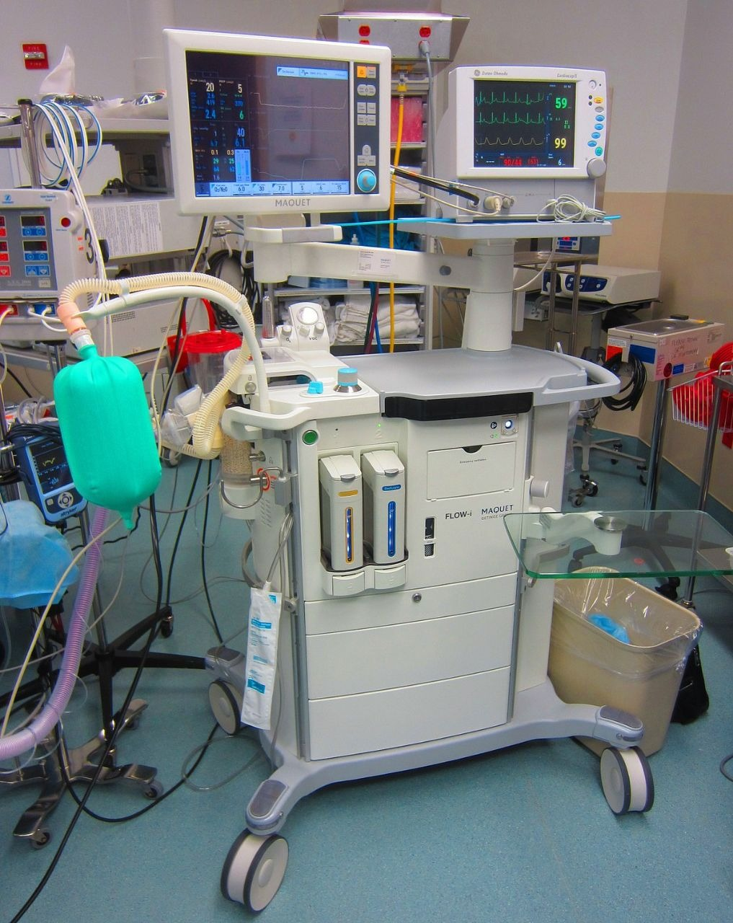

Slide 11
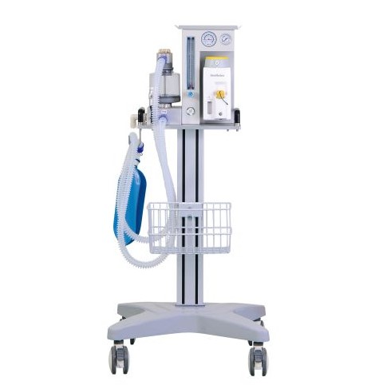

Slide 12
Functions Of Anesthesia Machine The machine performs four essential functions: 1- Provides O₂, 2- Accurately mixes anaesthetic gases and vapours. 3- Enables patient ventilation and. 4- Minimizes anesthesia related risks to patients and staff.

Slide 13
Parts of anesthetic machine:
1- High pressure system. 2- Intermediate pressure system. 3- Low pressure system . 4- Pressure gauge. 5- Yoke block. 6- Pressure regulator. 7- Flow control valves. 8- O₂ flush 9-Scale

Slide 14
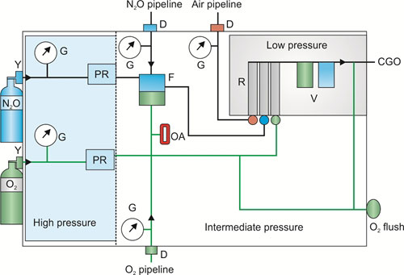

Slide 15
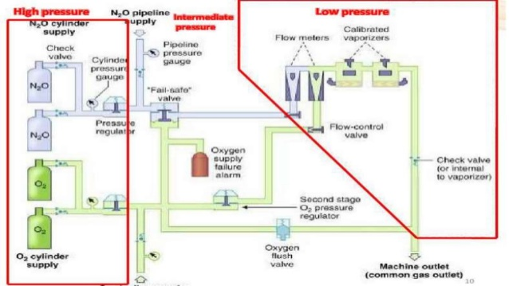

Slide 16
Types of anesthetic machine
1- Intermittent : gas flows only during inspiration. 2- Continuous : gas flow both during inspiration and expiration

Slide 17
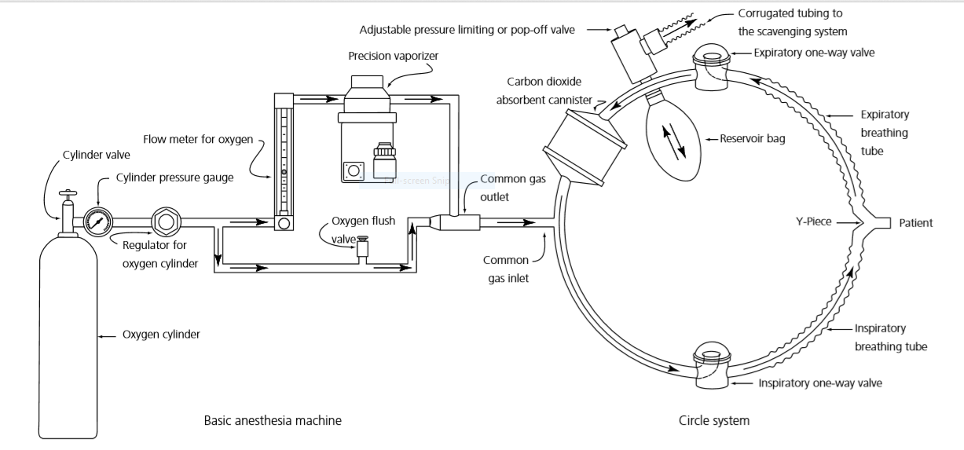

Slide 18
Among the gases used in the anesthetic machine are isoflurane, cefoflurane and halothene, and the most commonly used is isoflurane.
Isoflurane offers many advantages over other inhalational anesthetics. Its faster induction and recovery, relative sparing effect on cardiovascular function and cerebral blood flow auto regulation, and negligible metabolism make this drug particularly useful in the anesthetic administration of the debilitated, aged, or unusual veterinary patient.

Slide 19
Accessories of Anesthetic machine
1- VAPORIZ. 2- GAS SUPPLY. 3 – VENTILATION. 4 – MONITORS. 5 – ALARMS. 6– BREATHING CIRCUITS. 7 – CO2 ABSORBER. 8 – CAPNOGRAPH CO2. 9- GAS CYLINDER.

Slide 20
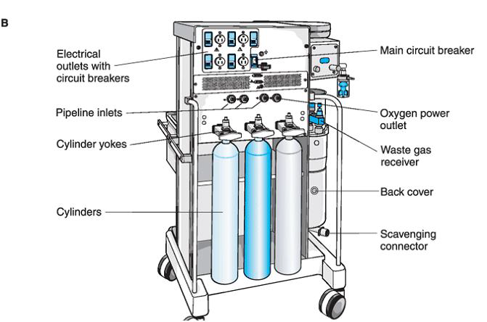

Slide 21
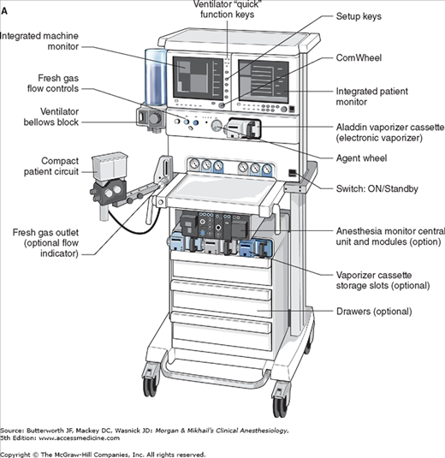

Slide 22
Advantages and disadvantages of anesthetic machine
Advantages:
Constant inspired concentrations.
Conserve respiratory heat and humidity.
Useful for all ages.
Useful for closed system or low-flow.
Low resistance.
Disadvantages:
Increased dead space.
Malfunctions of unidirectional valves.

Slide 23
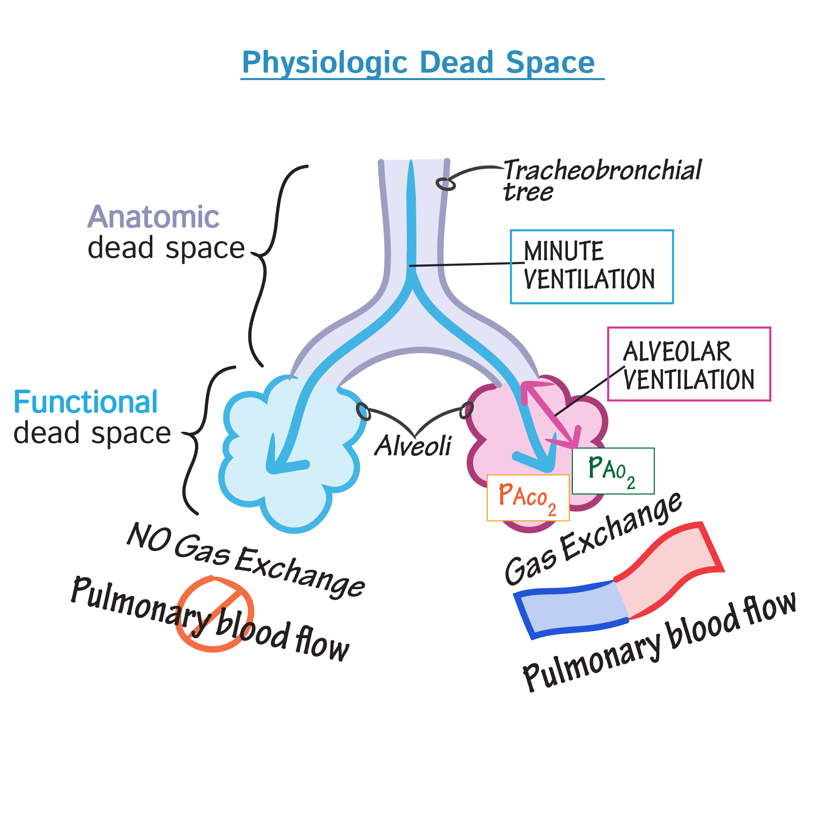

Slide 24
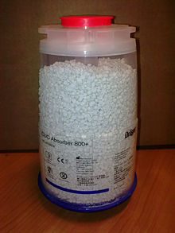
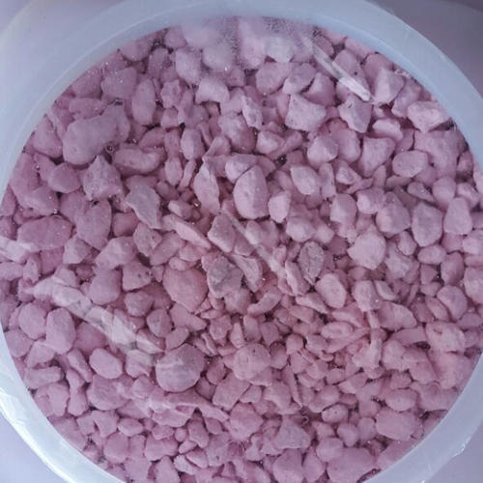
Soda lime (CO2 absorbant )
Calcium hydroxide
Barium hydroxide
Little amount of sodium and potassium hydroxide
Silica and kieselgahr which responsible soda lim granulles toughness
Fresh calcium hydroxide is soft and easily to crush
Expended calcium hydroxid is convered to calcium carbonates which is hard
Soda lim colour is white and can be changed to violet when expose to air
Heat line that appear on soda lime container is an indicator of active CO2 absorbition especially in large animal

Slide 25
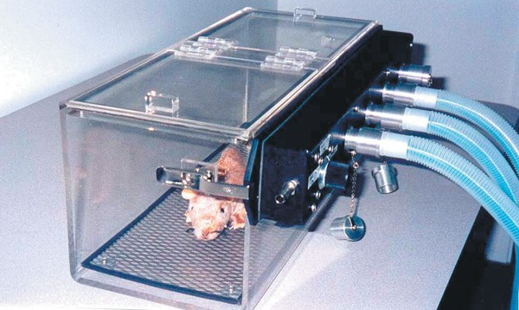
Closed container
Used for oxygenation and inhalant induction
Flow of fresh gas inside the chamber must be 2-5 liter/minut
Concentration of Inhalant anesthetic should increase gradually 5% every 10 second till 4%-4.5% of isoflurane or sevoflurane is injected
Oxygen must be injected in the chamber 5 minutes before inhalant drug is used

Slide 26
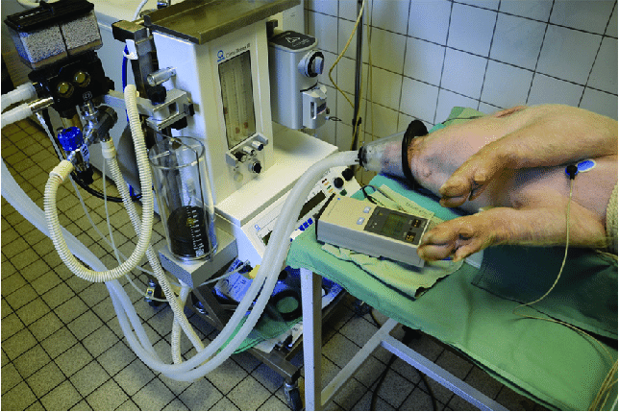
Masks
Mask induction is smoothest in depressed ,tranqulized ,or sedated patient.
Mask must be fitted on the animal muzzle.

Slide 27
THANKS

